Slide 1

Project committee meeting
SAP30/CMRL
On 2022-09-28

Slide 2
Agenda
Progress by module
Project performance monitoring
Budget review
Schedule review
Risk review
Action plan
Questions
Next Meetings

Slide 3
Progress monitoring: Finance
Done
To be done
FI / CO configuration and unit tests
Parameterization and unit tests Fixed assets
Corrections of encountered problems
Data set for validation of fixed asset calculations
Validation by key users
Accounts cleaning
Chart of Accounts agreement
Before integration tests:
Review the scenarios and complete the examples
Distribute tests by area of expertise
Finalize training materials
After the integration tests:
Adapt the consolidation test plan
Confirm the training plan and send the invitations
Complete the tests to adapt them to the pre-production environment
Workshops or meetings to organize
Review the Finance test results
Finalize the list of corrections and share it with experts Review and update the issues and risks register

Slide 4
Progress monitoring: Sales
Done
SD configuration and unit tests
Corrections
Key users validation
Cleansing the customer file
Customer hierarchy agreement
Rebates and discounts agreement
Collection of CRM requirements
To be done
Before integration tests
Review the scenarios and complete the examples Distribute tests by area of expertise Finalize training materials
After integration tests
Adapt the consolidation test plan Confirm the training plan and send the invitations Complete the tests to adapt them to the pre-production environment
Workshop or meeting to organize
Review of sales test results Finalize the list of corrections and communicate to the experts Review and update of the problem and risk register Meeting with CRM experts to establish the implementation plan

Slide 5
Progress monitoring: Purchasing
Done
To be done
Configuration and unit tests
Corrections
Validation by key users
Cleansing accounts payable
Expense management agreement
Agreement payment rules
Collection of "auction" requirements
Before integration tests
Review the scenarios and complete the examples Distribute tests by area of expertise Finalize training materials
After integration tests
Adapt the consolidation test plan Confirm the training plan and send the invitations Complete the tests to adapt them to the pre-production environment
Workshops or meetings to organize
Review of Purchasing test results Finalize the list of corrections and communicate to the experts Review and update of the problem and risk register Meeting with Ariba experts

Slide 6
Progress monitoring: Logistics
Done
MM setup and unit tests
Corrections
Validation by key users
Cleansing the product file
Transport management agreement
Storage rules agreement
Collection of interfaces requirements
Before integration tests
Before integration tests
Review the scenarios and complete the examples Distribute tests by area of expertise Finalize training materials
After integration tests
Adapt the consolidation test plan Confirm the training plan and send the invitations Complete the tests to adapt them to the pre-production environment
Workshops or meetings to organize
Review of logistics test results Finalize the list of corrections and communicate to the experts Review and update of the problem and risk register Meeting with interface experts

Slide 7
Progress monitoring: Production
Done
To be done
Configuration and unit tests
Corrections
Validation by key users
Collection of interfaces requirements
Before integration tests
Review the scenarios and complete the examples
Distribute tests by area of expertise
Finalize training materials
After integration tests:
Adapt the consolidation test plan
Confirm the training plan and send the invitations
Complete the tests to adapt them to the pre-production environment
Workshops or meetings to organize
Review of production test results
Finalize the list of corrections and communicate to the experts
Review and update of the problem and risk register
Meeting with interface experts

Slide 8
Progress monitoring: Master Data
Done
File cleansing
Fix issues (in progress)
Definition of needs during integration and consolidation tests
Preparation of test data sets
To be done
Before integration tests
Complete corrections
Complete datasets for testing
Coordination with other work area
After integration tests
Adapt consolidation datasets
Develop procedures for switching, correcting and loading data
User-validator selection
Workshops or meetings to organize
Review of correction and loading rules with CMRL experts
Finalize the list of corrections and communicate to the experts
Review and update of the issues and risks register
Selection of part-time resources to manage the volume of information

Slide 9
Project performance: Budget review
Notes:
Possible de détailler la performance par services/périmètres. Par exemple splitter cet indicateur entre finances/logistique/achats etc.

Slide 10
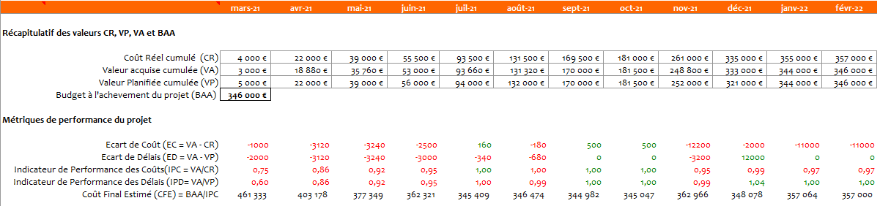
Project performance: Earned value analysis ½ *
See "Budget monitoring report" for more details

Slide 11
Project performance: Earned value analysis 2/2 *
See "Budget monitoring report" for more details

Slide 12
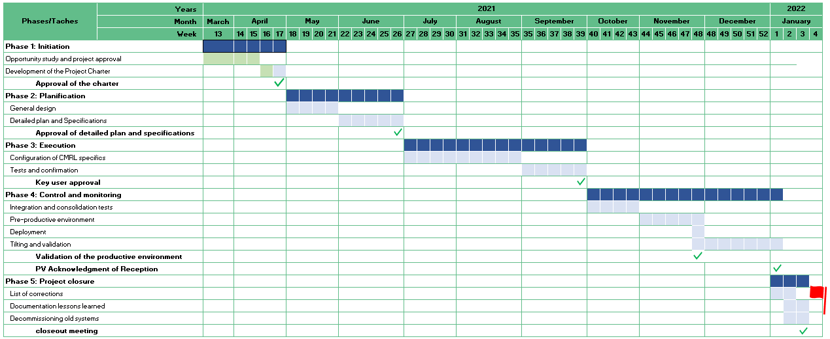
Performance de projet : Revue du Planning
Project performance: Schedule review
The movements of the past period :
Delivery of parameterized and tested systems in all areas of work
Data cleaning and corrections
Collection of interface requirements
Collection of CRM requirements
Validation by key users
Planned for the following period:
Integration test
Consolidation test
Finalized training materials
Detailed data failover plan
Detailed acceptance test plan for solutions in all areas of work
Preparation of the functional and operational changeover plan
Notes:
Possible de garder en référence la Baseline.
Et donc afficher le planning original et le planning réel, pour mettre en évidence les glissement de planning (en retard comme en avance d’ailleurs)

Slide 13
Project risks review
Description | severity | Probability | Criticality | Consequence if happen | Preventive Actions | Corrective Actions
Status-Quo | Catastrophic | Unlikely | Very critical | Cost, deadline, strategy | Start of the SAP CMRL project | Start of the SAP CMRL project
Control/Audit | Severe | Likely | Very critical | Cost and deadlines | Accelerated SAP implementation | Agreements with auditors
Lack of support or interest | Major | Unlikely | Critical | Deadlines and quality | Communication plan and assignment of a change manager | Transparent communication
Dependencies between projects | Major | Likely | Critical | Cost, deadline, strategy | SAP project and CMRL expansion project in the same portfolio | Change management
Deadline December 2022 | Major | Improbable | Moderated | Cost, deadline, strategy | Accelerated SAP implementation | Work during public holidays
* see "Risk register" for more details
Notes:
L’idée est de suivre l’évolution des risques tout au long du projet (Criticité, mesures préventives et correctives)

Slide 14
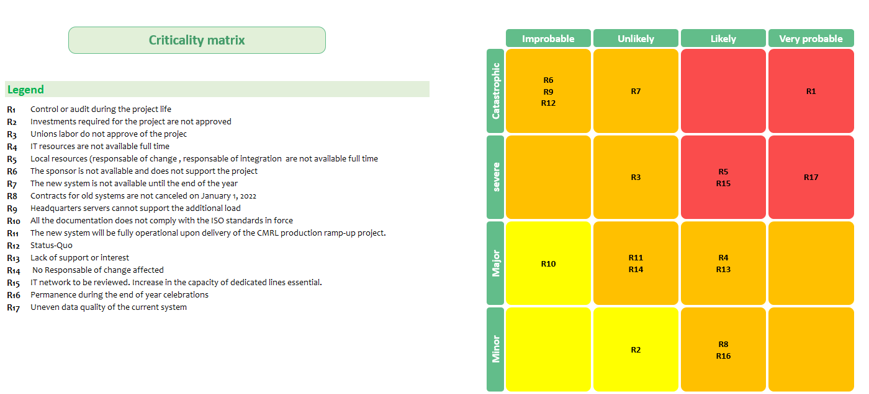
Project risk review: Risk matrix
* see "Risk register" for more details
Notes:
L’idée est de suivre l’évolution des risques tout au long du projet (Criticité, mesures préventives et correctives)

Slide 15
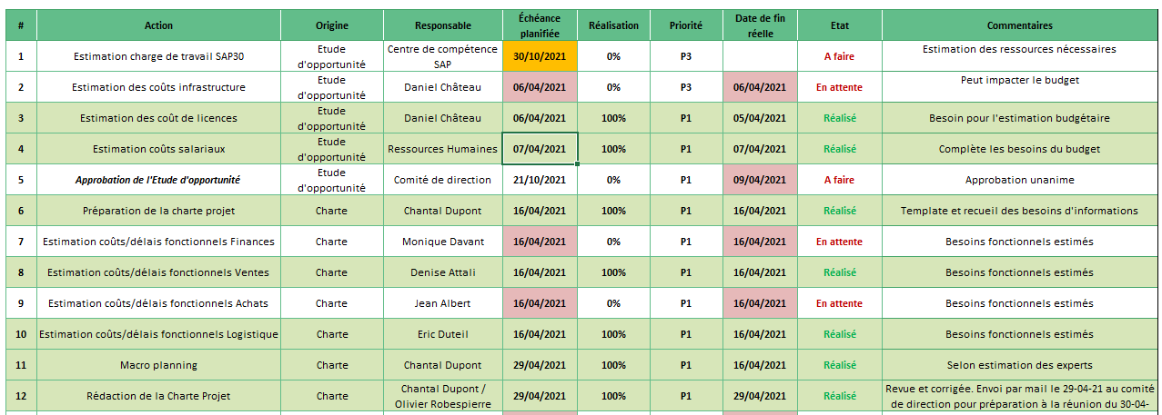
Action register
* see "Action register” for more details

Slide 16

Questions
Do you have any questions for the group?
Do you have questions or actions to communicate to the steering committee?
Updates or corrections?
Updates to the issues and risk register?

Slide 17
Next meetings
Next project committee meetings:
2022-10-01
2022-10-08
2022-10-15

Slide 18
Addition proposals:
Members present and excused
Follow-up of deliverables if necessary (see deliverables register)

